Slide 1
PREPARING FOR AN INTERVIEW
Before, During and After
Veteran’s Employment Series

Slide 2
GOAL OF THE EMPLOYER
Promote organization
Attract the best candidate
Gather information, and assess qualifications
Determine if the candidate fits the position

Slide 3
GOAL OF CANDIDATE
Gather information on the position and employer
Evaluate position, job-setting, culture of company and work environment
Determine if position is suitable – “Do I want to work here?”
Communicate information about yourself – convince employer to hire you because you are qualified for the position

Slide 4
KNOW YOURSELF
What are my skills and abilities?
What are my strengths?
How do my skills and experiences relate to the position and employers’ needs?
What contributions will I bring to the employer?
How do my values compare to the philosophy of the organization?
What points do I want to be sure to get across during the interview?
How does this position fit into my career goals?

Slide 5
PREPARE YOURSELF
Obtain a copy of the job description
Bring it with you
Use the employer’s information and the employer’s websites to gather information on the organization
(press releases, mission statement, employee
newsletters)

Slide 6
PREPARE YOURSELF
Make sure you understand the details, requirements, and responsibilities of the job you are applying for (This information can typically be found by reviewing job description and the corporate website)
Finally, be able to relate your skills and qualifications to the stated job responsibilities

Slide 7
RESEARCH THE ORGANIZATION
How old is the organization?
Where are the plants, or offices located?
What are its products or services?
If the organization sells, what are its markets?
Is it a public or non-profit organization?
Whom does it serve?

Slide 8
RESEARCH THE ORGANIZATION
What is the organizational structure?
How does the organization fit into the community?
What problems does the organization need to overcome? (By identifying the problems that the organization faces, you can match your abilities to these ends during the interview.)

Slide 9
PREPARE AND PRACTICE
Develop examples that highlight your skills
Prepare scenarios from your previous work experience to have ready
Practice answering questions (out loud)
Be aware of your body language
Remember to smile and be yourself!

Slide 10
CHECKLIST
Confirm date, time and place of interview
Pack several copies of your resume; a list of references, and letters of recommendation
Dress appropriately
Be punctual

Slide 11
WHAT TO DO
Arrive 10-15 minutes early.
Have pen and paper. Borrowing a pen indicates lack of preparation
Be enthusiastic. Recruiters remember a positive attitude
Listen carefully to questions before responding.
Unless asked, do not discuss salary and benefits

Slide 12
DRESSING FOR THE INTERVIEW
Wear clothing indicates you’re ready to work
Fresh and neatly pressed
Wear conservative shoes a clean and well-groomed hairstyle and fingernails
Wear minimal cologne or perfume
Be sure to empty your pockets, no noisy coins
No gum, candy or cigarettes

Slide 13
THINGS TO AVOID IN AN INTERVIEW
Do not discuss personal issues
Turn off your Cell Phone
No Chewing Gum
Poor personal appearance
Lack of interest and enthusiasm; passive/indifferent
Over-emphasis on money
Criticism of past employer
Tardiness
Failure to express appreciation for interviewer’s time

Slide 14
THINGS TO AVOID IN AN INTERVIEW
Failure to ask pertinent questions about the position
Inability to express self clearly; weak voice, poor diction, poor grammar
Lack of confidence and poise, nervous

Slide 15
SELLING YOURSELF
Introduce yourself with a smile and handshake
Maintain good eye contact
Demonstrate the benefit of hiring you
Answer questions with: "Yes/No, for example (accomplishment/result statement)"
Show interest in what the interviewer is saying, by nodding and leaning toward them

Slide 16
SELLING YOURSELF
Give positive answers to negative questions
Ask prepared questions
Ask what the next step is
Ask for business card for future contact
This is for follow up and closure!
Make notes of important points immediately after leaving your appointment

Slide 17
QUESTIONS YOU MAY ENCOUNTER ON AN INTERVIEW
Personal Motivation and Traits
What motivates you to do your best work?
Tell me about a time you went "out on a limb" to get the job done?
What do you find most frustrating at work?
Tell me about a project that got you really excited?
Under what conditions do you work best?
What is your greatest strength/weakness?

Slide 18
QUESTIONS YOU MAY ENCOUNTER ON AN INTERVIEW
Goals
Tell me about your 5-year goals?
How do you define "success”
Do you set goals for yourself?
How do you keep them current?
Do you achieve your goals most of the time?

Slide 19
QUESTIONS YOU MAY ENCOUNTER ON AN INTERVIEW
Communication
Do you prefer to speak directly or communicate though writing?
Do you feel you communicate effectively with peers, clients and senior level management?

Slide 20
QUESTIONS YOU MAY ENCOUNTER ON AN INTERVIEW
Flexibility
Tell me about the last significant change which occurred in your work environment
How did you respond to this?
Tell me about a time when a work emergency caused you to reschedule your work/projects
Can you provide me with an example of the last time you went above and beyond what your employer or client required?

Slide 21
QUESTIONS YOU MAY ENCOUNTER ON AN INTERVIEW
Stress
Tell me about an unexpected deadline you had to meet
Were you successful?
Have you worked in a fast paced, hectic environment?
Did you work effectively in this the environment?
What kinds of decisions are most difficult for you?
How did you resolve the situation?

Slide 22
SAMPLE QUESTIONS TO ASK DURING YOUR INTERVIEW
Asking questions indicates to the employer your job search has been well thought out
The following are samples of questions you can ask in an interview
Do not memorize these samples, figure out how they translate into suitable questions for the organization you are interviewing with

Slide 23
Questions to ask the interviewer
What three key skills are vital to this position?
How is an employee evaluated and promoted?
Tell me about your training programs
What are the challenging aspects of this job?
Is it company policy to promote within?
What qualities are you looking for in your new hires?
What’s the next step in the hiring process?
Can I provide any other information to help in the decision-making process?
Do not ask about salary and benefits

Slide 24
Five things most employers want to know about you
1. Are you qualified for the position?
What are your greatest strengths?
Do you have experience in this field?
What do you believe you bring to this job?
Why should I hire you?

Slide 25
Five things most employers want to know about you
2. What motivates you?
What motivates you to put forth your greatest effort?
Where do you see yourself five years from now?
What is more important to you, the money or the job?
What did you like most about your last job?

Slide 26
Five things most employers want to know about you
3. Tell me about the negatives
Why did you leave your previous job?
What did you like least about your last supervisor?
What is your greatest weakness?
What did you like least about your last job?
Why have you been unemployed so long?

Slide 27
Five things most employers want to know about you
4. Are you a good fit?
What kind of people do you find it hard to work with?
Tell me about a time when you worked as a member of a team.
In what kind of environment are you most comfortable?
Do you prefer to work alone or with others?

Slide 28
Five things most employers want to know about you
5. Do you want the job with their company, or do you want a job?
What are you looking for in a position?
Who else are you interviewing with?
Why are you interested in this position?
What do you know about the company?

Slide 29
AFTER THE INTERVIEW
Evaluating your performance after the interview: 1. List 3 things which made the interview a success 2. List 3 things about the interview that you would change For each of these three items, explain what you are going to do to improve for your next interview. 3. What skills/qualities were important to the employer? How could you better present these skills next time? 4. What further information do you need in order to determine if you would accept an offer? 5. List the pros and cons of this position including information on the company, management style, location and growth potential

Slide 30
AFTER THE INTERVIEW
The interview is over, but your work is not done!
It is imperative to send a thank you letter to the person(s) who interviewed you within twenty-four hours after the interview
This reinforces your interest in the position and can serve as an additional opportunity to separate you from the other candidates by recalling a notable topic or attribute discussed in your interview

Slide 31
AFTER THE INTERVIEW
Most employers will tell you when you can expect to hear from them. If you do not hear by that date, it is appropriate for you follow up with a phone call
If the employer requests additional materials, such as an application, transcripts, or references, send them as soon as possible
If an employer indicated an interest in pursuing things further with you, but you are no longer interested inform them as soon as possible in a polite and professional manner

Slide 32
THE THANK YOU LETTER
Send within 24 hours of your interview
The letter should be brief and include the following:
Keep the letter short, less than one page
Send a thank you letter for every interview
Demonstrate employer knowledge in 2-3 sentences
Thank the interviewer for his/her time
State the position for which you are applying
Restate employment objective
Mention something from your interview to remind the interviewer of your meeting

Slide 33
SAMPLE THANK YOU LETTER
January 6, 2020
Ms. Jones
Director of Administration
Corporation X
21st Avenue North
Clearwater, FL 33754
Dear Ms. Jones:
It was such a pleasure meeting with you, and Ms. Sofer this morning. I appreciate the time you spent with me introducing me to your company and discussing the opening for an Outside Sales Representative. I am confident that my history of success in this arena, enthusiasm and persistence will enable me to be successful in this role. Additionally, I have the ability to work with both internal and external clients of varied cultures which I believe to be an essential component to success in this position.
I am looking forward to speaking with you further at your convenience and discussing the possibility of becoming a member of your team.
Sincerely,
Anita Jobseeker
(787) 275-6446
cc: Ms. Charlene Myers Ms. Juana Sofer
HR & Communications Director General Counsel

Slide 34
ELEVATOR SPEECH
The “Elevator Speech” is a brief statement that communicates who you are, what you want to do, and what value you bring to the employer. Your Elevator Speech should be tailored to the circumstances at the time presented
(Tell me about yourself)
The Elevator Speech should be: clear, concise, focused and specific
Limited to no more than 60 seconds
(ideally, about 30 seconds)

Slide 36
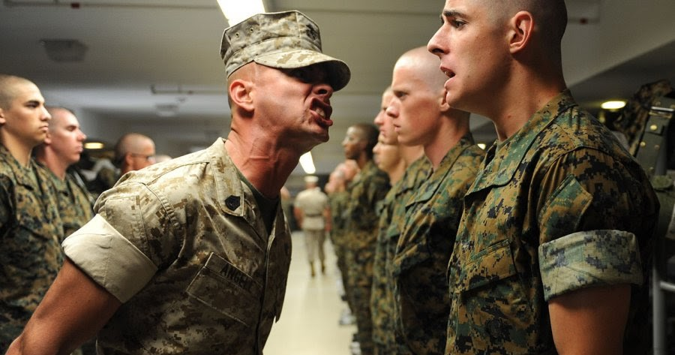
Questions

Slide 37
CareerSource Pinellas Veteran Services Contact:
Natalia Dolsak, FCWP
DEO Veterans' Program Manager/Supervisor
Veterans at Work SHRM Certified
ndolsak@careersourcepinellas.com
Tel: 727-608-2486

