Slide 1
O*net Online
Veteran’s Employment Series

Slide 2
What is Onet Online
Onet Online is the online version of the dictionary of occupational titles.
It is supported and maintained by the Bureau of Labor Statistics.
Onetonline.org

Slide 3
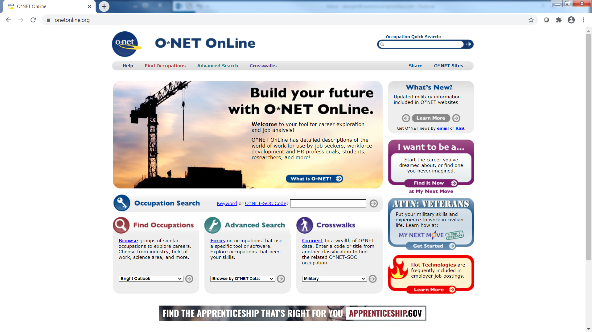

Slide 4
What can OnetOnline.org do for me ?

Slide 5
Some examples of what ONET can assist you with:
Military Skills Translation (MOS)
Interest and Skills Assessments
Career Exploration Data
Resume (job description) Data
Salary Ranges for Specific Titles
Projected Job Growth
Help Find Regional Jobs

Slide 6
1. Military Skills Translation (MOS)
On the main page
Select the ATTN: VETERANS icon.

Slide 7
MOS Translator
Career Search
Interest Profiler
Industry Search
Veteran Resources
Partner Sites

Slide 8
1. Military Skills Translation (MOS)
The next page is MY NEXT MOVE FOR VETERANS.
Go to the find careers like your military job Menu
Select your branch of service and then your MOS

Slide 9
1. Military Skills Translation (MOS)
I put in 0311 for the Marine Corps and it offered some potential job titles.

Slide 10
2. Interest and Skills Assessments
On the My Next Move For Veterans Page Look for this link

Slide 11
2. Interest and Skills Assessments
When the Interest Profiler prompts, click the next button

Slide 12
2. Interest and Skills Assessments
How it works…

Slide 13
2. Interest and Skills Assessments
Once you complete, you can view the results

Slide 14
2. Interest and Skills Assessments
It will recommend some careers

Slide 15
2. Interest and Skills Assessments
You will then be asked a series of questions about your skills and interests.
When you complete the questions, you will get recommendations on careers and your work interests and traits, print this out to use for exploring careers on the Onet online site.

Slide 16
3. Career Exploration Data
On the main Onet page, type a career in the Occupation Quick Search Box
Then hit enter

Slide 17
3. Career Exploration Data
I input Security Guard and hit enter, this is the result – click on the job title.

Slide 18
3. Career Exploration Data
Occupational Code
For Security Guard
Job Tasks / Skills
1. Do these skills align with your skills?
2. Is this something you can do and want to do?

Slide 19
3. Career Exploration Data
Scroll to the education section to see what education level is predominant for this career field

Slide 20
3. Career Exploration Data
ONET will usually recommend some related occupations as alternatives to original choice

Slide 21
4. Resume (job description) Data
If you unfold the task section, you can see a list that is exactly what should be in the summary of qualifications on a resume for Security Guard.

Slide 22
5. Salary Ranges for a Specific Title
Salary Range National

Slide 23
6. Projected Growth for a Specific Job
Projected Growth for 10 Years

Slide 24
7. Find Regional Jobs
Click Find Jobs

Slide 25
7. Find Regional Jobs
Select Your Desired ZIP Code OR
Select Your Desired State

Slide 26
7. Find Regional Jobs
Once the job screen comes up you can change some of the search criteria to narrow your search

Slide 27
CareerSource Pinellas Veteran Services Contact:
Natalia Dolsak, FCWP
DEO Veterans' Program Manager/Supervisor
Veterans at Work SHRM Certified
ndolsak@careersourcepinellas.com
Tel: 727-608-2486

