Slide 1
Resume Development
Veteran’s Employment Series

Slide 2
Tips Before Starting a Resume
A resume is an important tool for a job search
Allows a candidate to display his/her top skills and qualities
Resumes help employers make hiring decisions
The average recruiter spends 6 seconds reading a resume
Ensure your resume contains keywords from the job description
Resume should be freshly printed on high quality paper
Font size should be no smaller than 11 points
Calibri or Times New Roman are good choices
Resumes should be 1 to 2 pages, with 1 page being ideal
Spelling and Grammar are important (attention to detail)
Do not overuse capitalization, bold, italic or underlines

Slide 3
Things to Avoid on a Resume
Do not exceed three to five bullets per section
Do not use a funny yet controversial email address
Do not bother with an objectives section
Do not use acronyms or jargon
Do be consistent with content
Do not include high school if the candidate has any college experience
Do not have a single typo or grammatical mistake
Do not split sections between separate pages on a resume

Slide 4
Soft Skills (Transferable) for Your Resume
1. Team Player – if you often consider the team’s welfare first before your own. In every achievement that you have, you will usually credit the team. You also have an active participation in every team activity.
2. Problem Solver – one of the best soft skills anyone would have. Companies are always on the lookout for candidates who have the ability to identify different problems, find the solution and implement the solution effectively.
3. Confidence – the ability to tackle problems without hesitation is a sign of confidence. It’s also part of the leadership skills that are sought after by most companies.
4. Flexibility – if you have the ability to adjust to any type of schedule (working on weekends, nightshift, etc.) then you have this soft skill.
5. Can Easily Handle Pressure – grace under pressure is a great soft skill as companies are growing to be more and more demanding from their workers. If you are able to be productive even with intense pressure, you have this soft skill.

Slide 5
Hard Skills (Specific to Job) for Your Resume
1. Technical skills include specialized knowledge and expertise in fields such as IT, engineering, or science. Typical technical skills are abilities to use specialized software or equipment.
2. Computer skills are your abilities to use software and hardware: from basic and general, to highly specialized, computer skills are a must in any industry. Be sure to include list them on your resume especially if you’re applying for office jobs and if the job ad requires specifics.
3. Microsoft Office Skills - Microsoft Office Suite, commonly known as Microsoft Office or simply Office, is a set of productivity tools used by businesses around the world. However, it's used for much more than just writing texts in Word and creating tables in Excel. This suite enables users to perform hundreds of advanced tasks, some jobs require only the basics. But for most of mid- and high-level positions you need to know a few tricky functionalities, too.
4. Analytical skills are the skills of gathering data, analyzing it, deciphering the meaning, and presenting it. No matter what job you’re pursuing, if you’re able to show that you’re good with data analysis, the recruiter will score you some bonus points.
5. Marketing skills include the general knowledge of sales, advertising, and consumer research, as well as a plethora of highly technical, digital skills required for success in modern-day online marketing. Marketing hard skills are of greatest value to candidates in media, advertising, social media, e-commerce, and product management.
6. Presentation Skills - Sure, you need certain soft, transferable skills to deliver a good presentation: confidence, adaptability, self-awareness, or stress management. To facilitate your presentation or report, you’ll need at least a few of these hard skills: Visual communication, Slideshows, Research, Data analysis, Reporting, Persuasion and Graphic design.

Slide 6
Resume Formats
Federal
Chronological
Functional
Combination (Hybrid)
New Graduate
Just to name a few!

Slide 7
Federal Resume
Federal – Required for applying to federal job openings, very detailed and long. www.usajobs.gov
A Federal resume is useful for people who are:
• Applying for government positions, federal and local
• Applying with Federal Contractors
• Applying with Defense Contractors

Slide 8
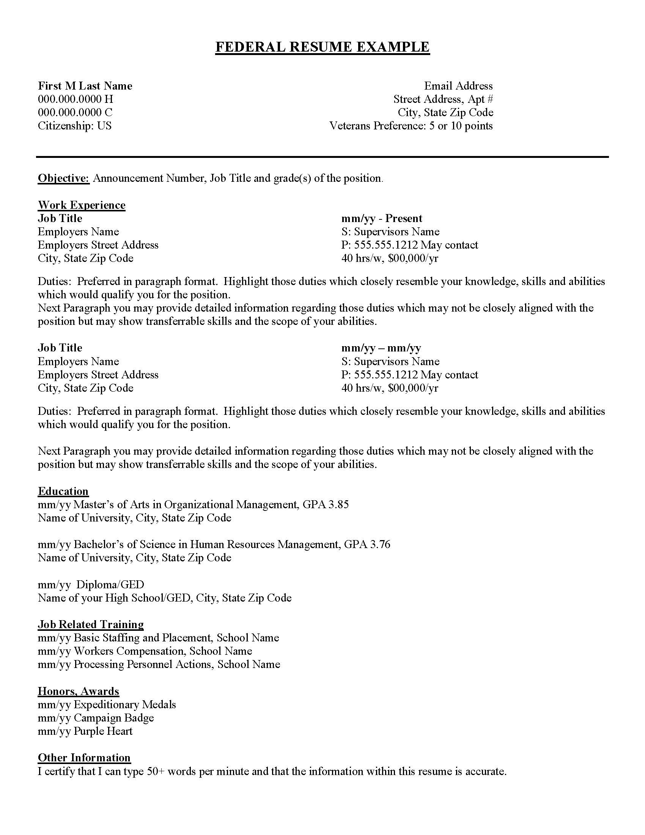
Federal Resume
Sample

Slide 9
Chronological Resume
Chronological- A chronological resume focuses on work experiences, listing employment history with the most recent first, as well as ample detail about job duties and accomplishments.
A chronological resume is useful for people who:
• Have a steady career track
• Have extensive experience within a certain industry
• Want to stay within the same industry

Slide 10
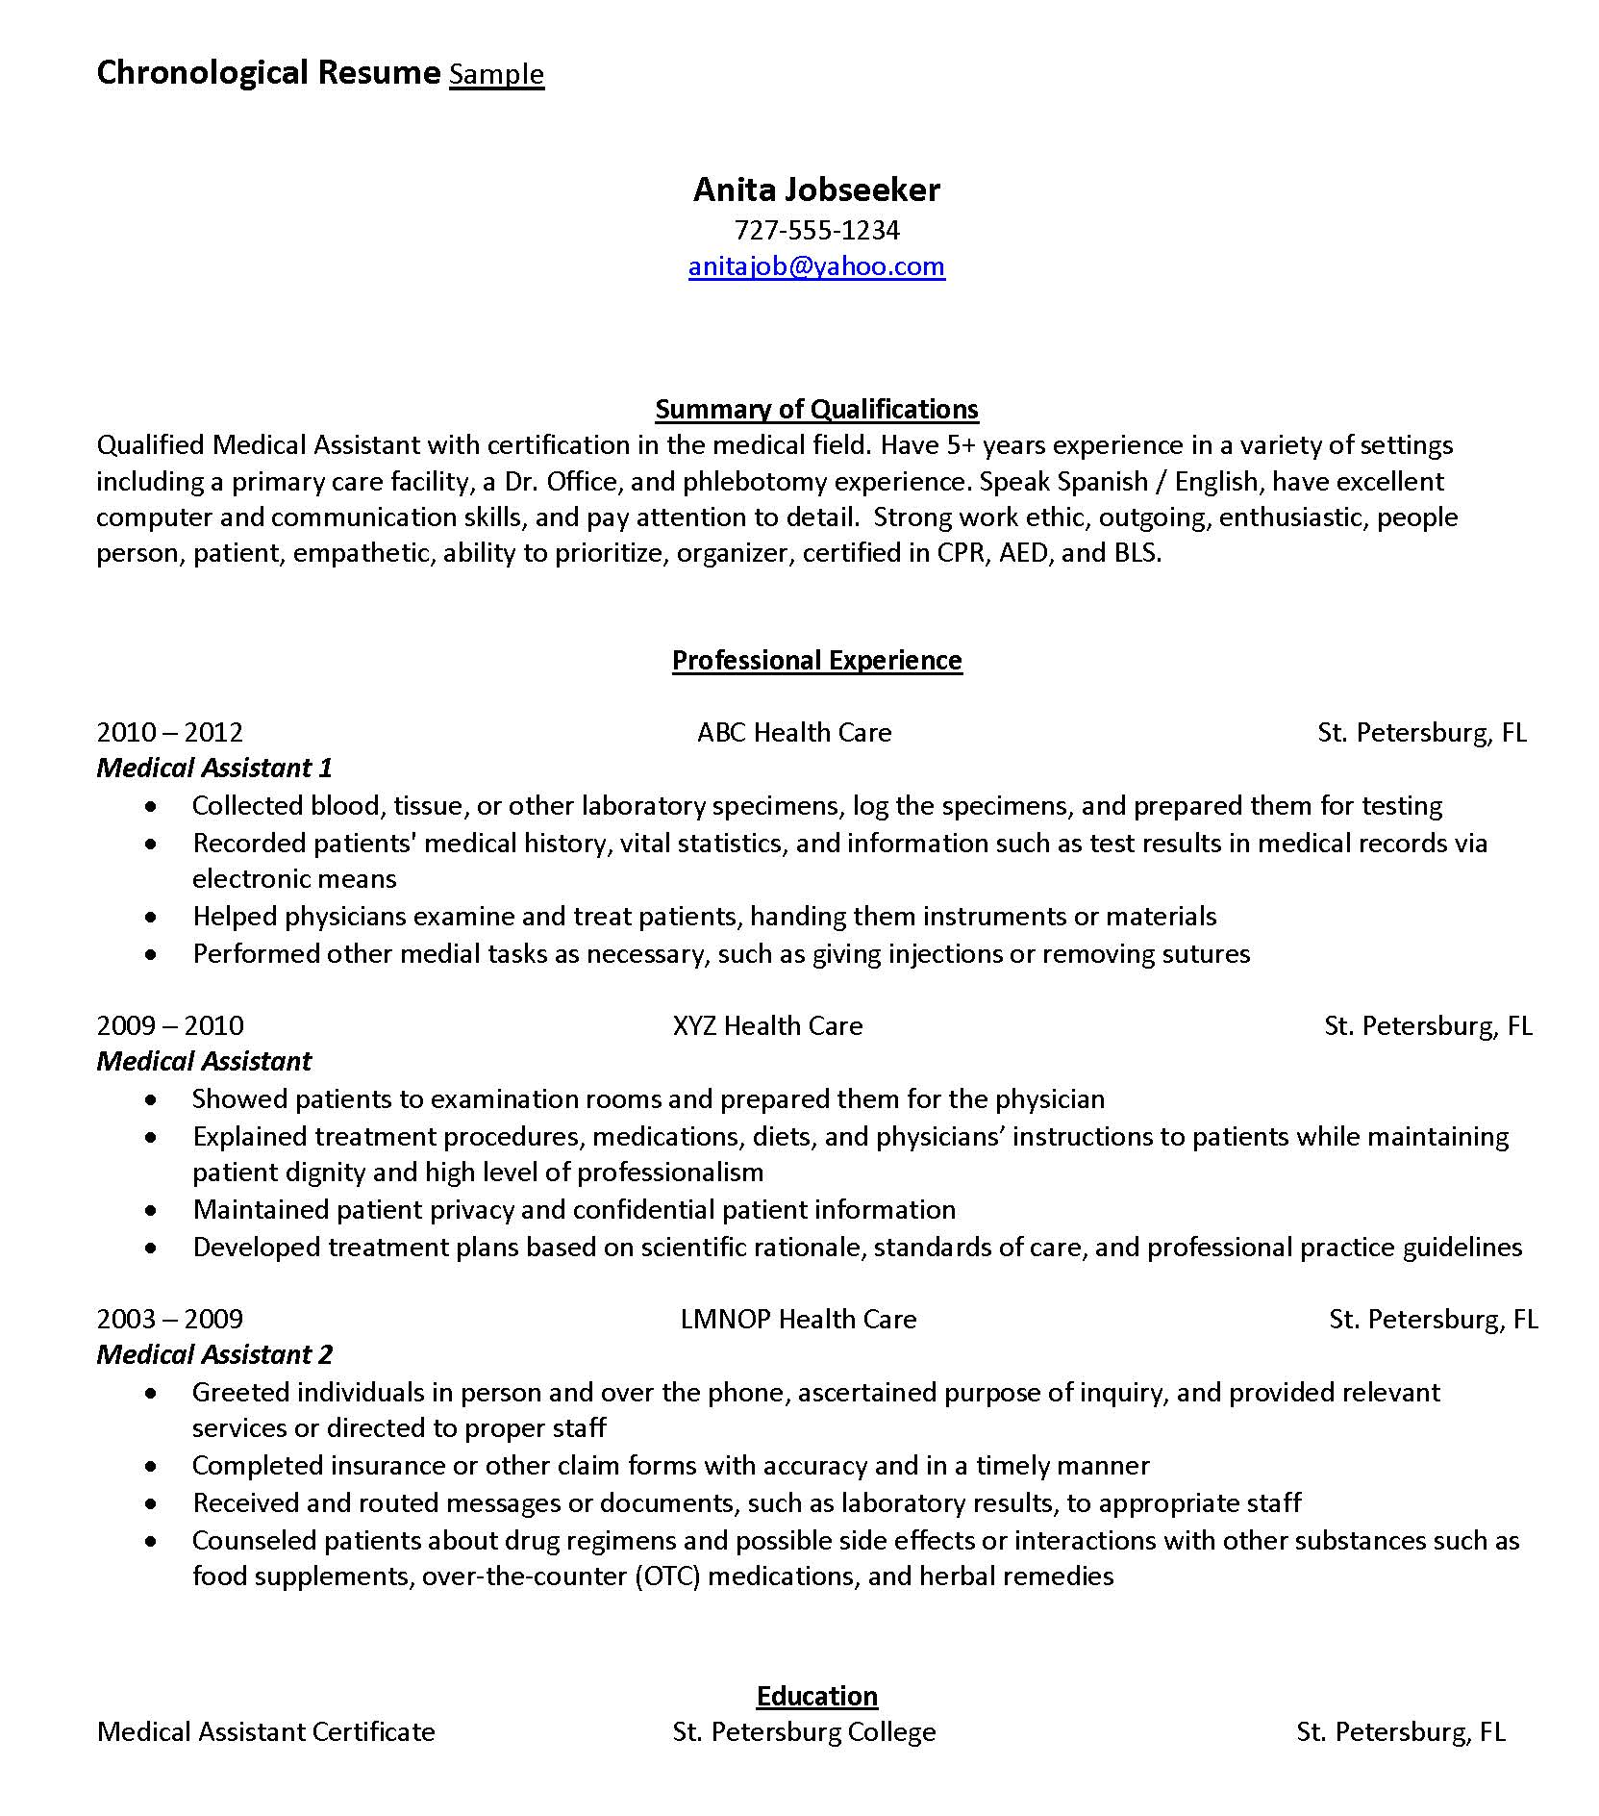
Chronological
Resume
Sample

Slide 11
Functional Resume
Functional - A functional resume highlights key skills and downplays work experience. Functional resumes are a good choice for career changers making a radical career shift and job seekers with unique work histories, including excessive job- hopping and employment gaps.
A functional resume is useful for people who:
• Have gaps in their work history
• Are re-entering the workforce
• Have frequently changed jobs
• Are transitioning into a new career field

Slide 12
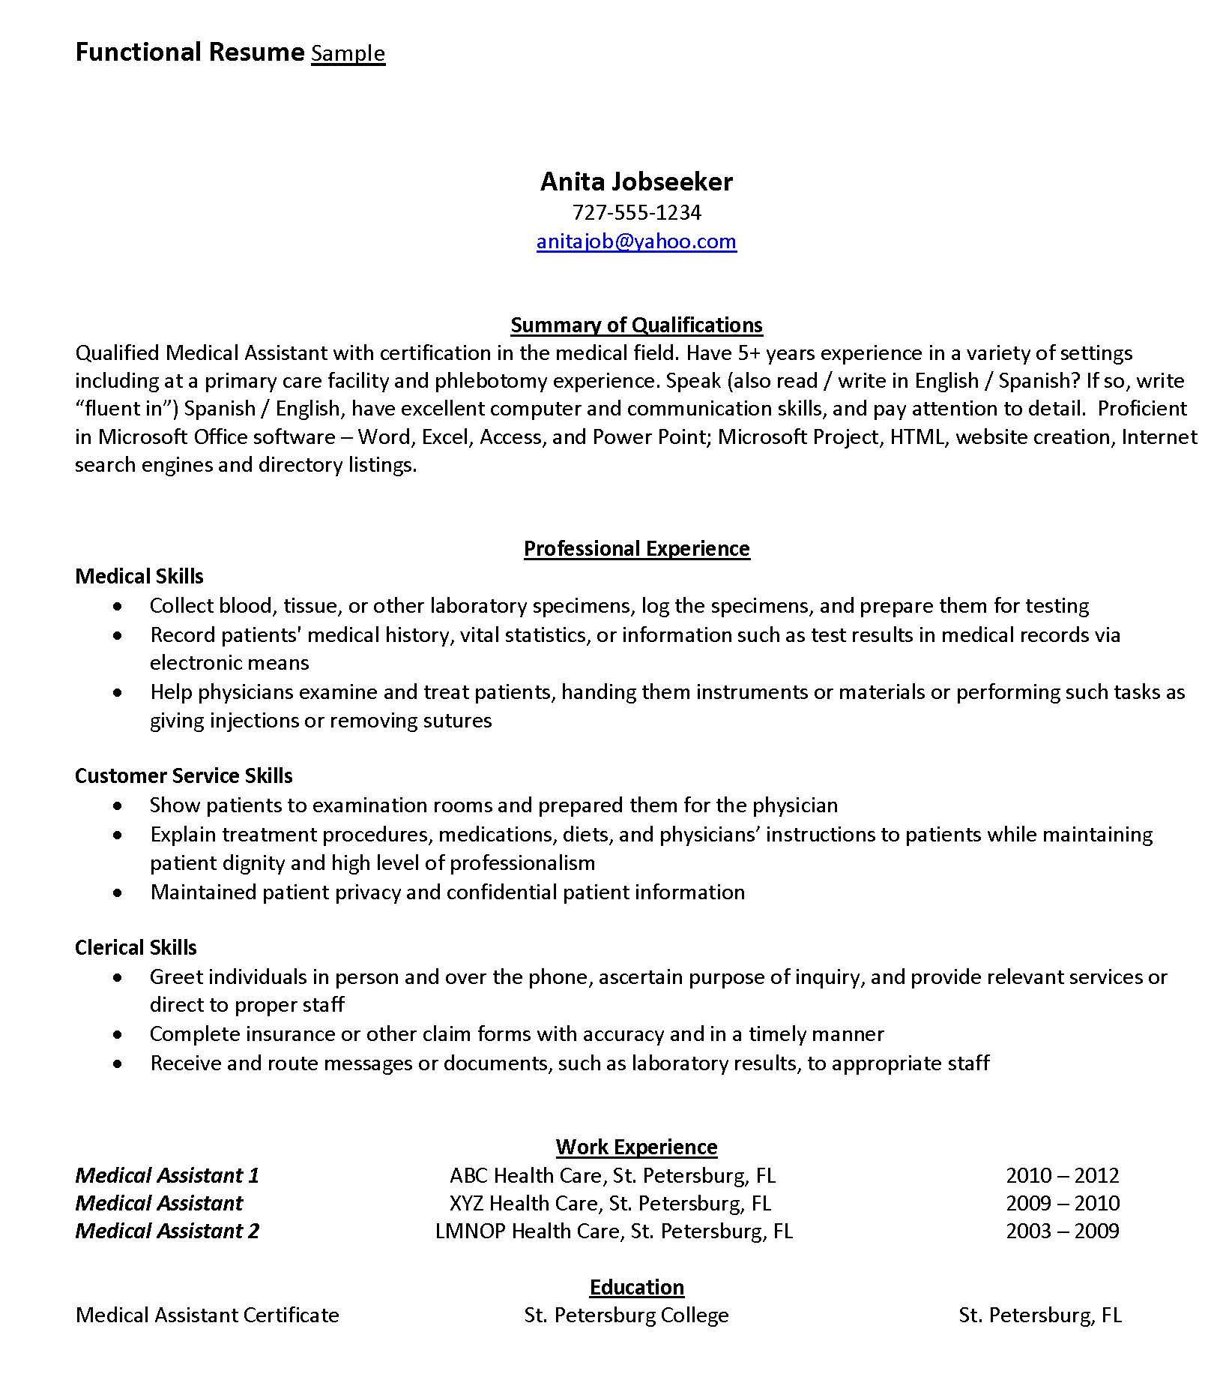
Functional
Resume
Sample

Slide 13
Combination (Hybrid) Resume
Combination Resume (Hybrid) - Incorporates the best of the chronological and functional formats.
Allows you to state your most relevant qualifications first, while providing the employment timeline that many hiring managers like to see.
Job seekers who would benefit from using a combination resume are:
• Students and New Graduates
• Entry-Level Job Seekers
• Workers with a Consistent Employment History
• Applicants making a career change
• Applicants re-entering the job market
• Mature workers

Slide 14
Combination (Hybrid) Resume
This class will focus on the
Combination/Hybrid resume
We will call it Hybrid for simplification
We will walk through each element of a Hybrid resume
Finally, we will show a finished example

Slide 15
The Hybrid Resume
What is a Hybrid resume?
It is a simple resume that allows you to quickly format a resume to the specific job description of an open job, based on your areas of expertise.
It is usually one page.
It is a popular and successful resume format.
It combines the best elements of the chronological and the Functional.

Slide 16
Header/Contact Information
If you don’t add a way for them to contact you, how will they?
Name – Should be bold, can be all caps, should be your formal name
City/State – Doesn’t need to have your whole address can be just city and state
Email – should be professional, no cute or crude addresses
Phone Number – out of state/long distance number, consider changing it
LinkedIn link – if you have a LinkedIn account add the address or hyperlink
Example:
JOE VETERAN
Tampa, FL
joveteran@wahoomail.com • 727-867-5309 • LinkedIn link if you have one

Slide 17
Occupational Objective
What type of Job are you applying to? Systems Analyst, Over the Road Truck Driver….
Or what is your skill set? Information Technology
Example:
Over the Road CDL Truck Driver

Slide 18
Summary of Qualifications
List what qualifies you for this position
(if unsure use Onetonline.org)
Example:
SUMMARY OF QUALIFICATIONS
Professional Truck Driver with over 5 years of safe driving. Possess a current CDL Class “A” license with Tanker and Hazmat endorsements. Understand the importance of maintaining the vehicles and all laws associated with safe driving. Capable of driving flatbeds, tankers and have my forklift and OSHA certifications.

Slide 19
Skills
List the skills that you possess that will make you stand out
Example:
SKILLS
CDL Class “A”
OSHA Card
Tanker/Hazmat
Vehicle Maintenance
Electronic Logs
Safety Focused
Flat Bed
Tankers
Princeton/Moffet
Forklift Certified
5.5 years’ Experience
Loading
Vendor Relations
Paperwork
Training/Mentoring

Slide 20
Areas of Expertise
List your areas of expertise with a summary of how you are an expert in that area. You should list no more than 3 areas of expertise.
Example:
AREAS OF EXPERTISE
CDL Truck Driver (Tanker) (1st area)
• Safely Operated a 40ft Tanker Truck
• Loaded and unloaded fuels safely
• Maintained logbooks and vendor receipts/purchase orders
• Trained rookie drivers on safe driving and loading practices

Slide 21
Areas of Expertise
AREAS OF EXPERTISE continued
Example:
Ice Cream Truck Driver (2nd area)
• Safely operated small van around children
• Rotated inventory of ice cream and popsicles
• Cash handling and accounting log

Slide 22
Employment History
Include employment going back 15 – 20 years in reverse order, starting with most recent employment
Job Title, Company Name, City State, Dates of employment ex: 6/2006 – 6/2020

Slide 23
Employment History
Example:
EMPLOYMENT HISTORY
Tanker Driver PDQ Tank lines Inc. Tampa, FL 6/2015 – 6/2020
Ice Cream Truck Driver Polar Ice Inc. Clearwater, FL 5/2005 – 5/2015

Slide 24
Military History
List the branch of service and type of discharge if applicable
Example:
MILITARY HISTORY
Honorably Discharged US Army Veteran (Retired)

Slide 25
Education/Professional Development
List Degree, School, city and state, date of graduation
List licenses and certifications
Professional Development = Six Sigma, Dale Carnegie, Toast Masters, ISO 9000, Lean Manufacturing, Continuous improvement, Advanced Problem Solving, Root Cause Analysis…..
Example:
EDUCATION/PROFESSIONAL DEVELOPMENT
Diploma - Tampa High School, Tampa, FL
CDL License - Road Masters Truck Driving School – 7/2014 – Exp 7/2022
Hazmat and Tanker Endorsement
Forklift License – PTEC
OSHA Card

Slide 26
Awards/Affiliations
Only list major awards
List organizations that you belong to that align with civic activity or relate to the job you are applying for
Example:
AWARDS/AFFILIATIONS
Bronze Star – OEF/OIF
Safe Driver of the Year – PDQ Tank Lines (2017)
American Legion – Member since 2004

Slide 27
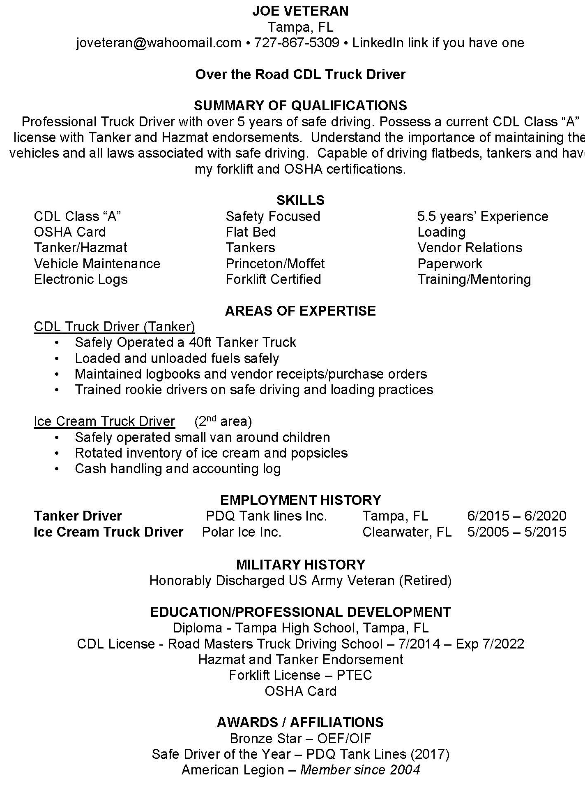
Final Hybrid
Resume
Example

Slide 28
Cover Letter Overview
The main purpose of a cover letter is to interest the employer in reading your resume.
Really think about why you want this job, and why your experience makes you the one they should call first (Implied Benefit)
Candidates can use the cover letter to highlight the aspects of their resume, that are relevant to the position, keep it short
Ensure that the experiences/qualifications listed match the requirements of the job

Slide 29
6 Key Cover Letter Elements
There are six things to include in your cover letter
Contact Information
Which job you’re applying to?
Why you’re interested in the job?
What relevant experience makes you a good candidate?
State that you’d like an interview
State that you’re grateful for being considered

Slide 30
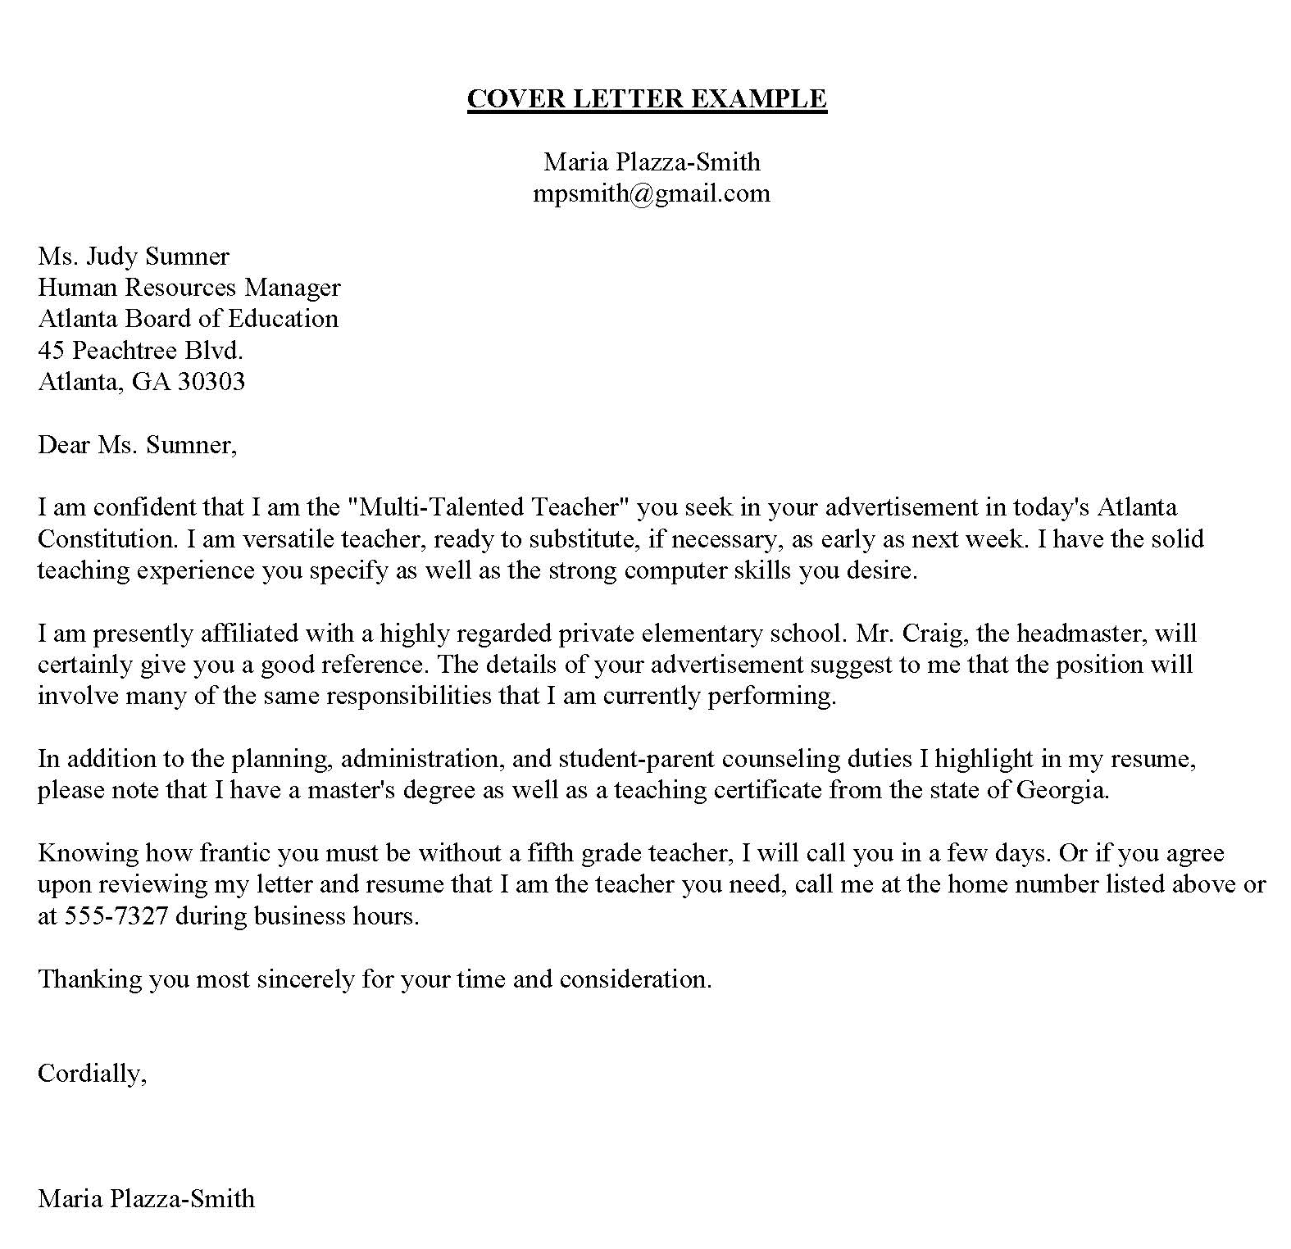
Cover Letter Example

Slide 31
Additional Resources
www.careersourcepinellas.com
www.employflorida.com
www.careeronestop.org
www.indeed.com
www.ebenefits.va.gov/ebenefits/jobs
www.learningexpresshub.com/
www.gcflearnfree.com
www.mynextmove.org
www.onetonline.org
www.myskillsmyfuture.org
www.usajobs.gov

Slide 32
CareerSource Pinellas Veteran Services Contact:
Natalia Dolsak, FCWP
DEO Veterans' Program Manager/Supervisor
Veterans at Work SHRM Certified
ndolsak@careersourcepinellas.com
Tel: 727-608-2486

