Slide 1
USAJOBS.gov Account
How to Create an Account and Apply to Federal Jobs
Veteran’s Employment Series

Slide 2
USAJOBS.gov – Objectives
Creating an account on USAJOBS.gov
Creating a profile (required to apply to jobs)
Uploading required documents
Federal Resume using the resume builder
Job searching and job search tips
Saving Job Postings
Applying to Jobs
Checking the status of a job
Veteran’s preference SF15

Slide 3
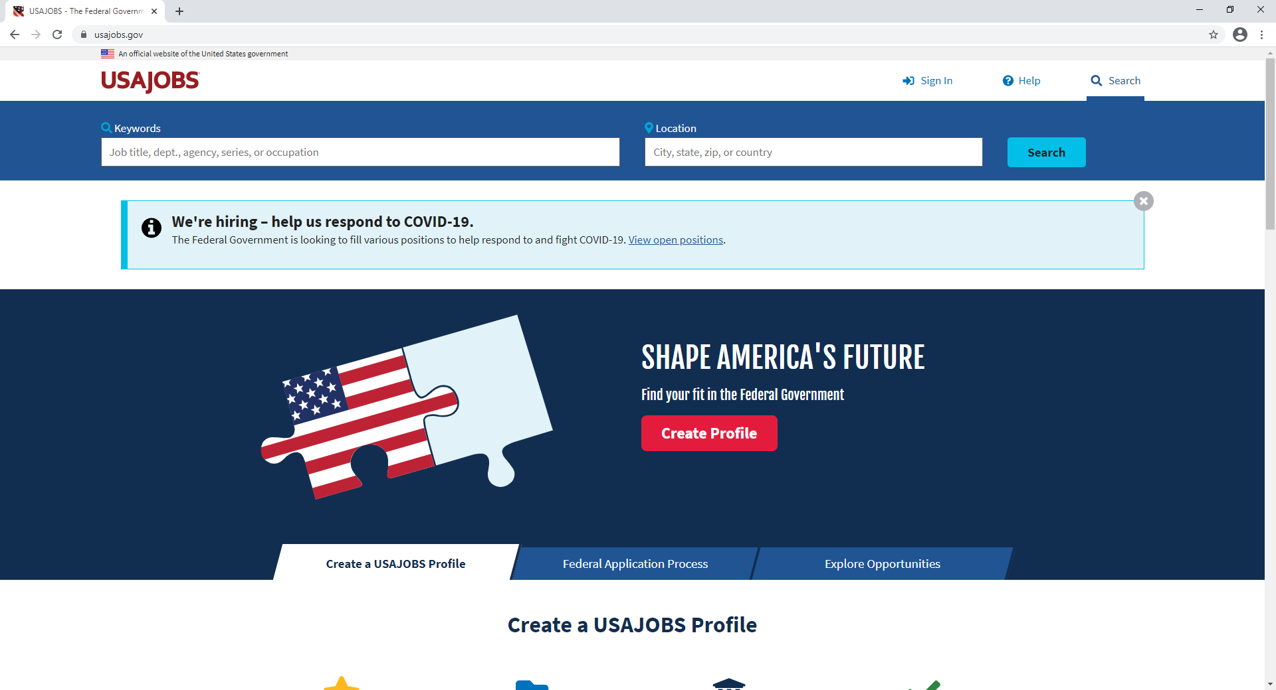
1. Creating an account on usajobs.gov
1. Navigate to the website www.USAJOBS.gov
1a. If you already have an account, sign in
2. Click on the Create Profile button

Slide 4
1. Creating an account on usajobs.gov
Click on Create an account

Slide 5
1. Creating an account on usajobs.gov
Follow the instructions that prompt on each following screen, then hit submit

Slide 6
2. Creating a profile
To apply to jobs on USAJOBS.gov you must create a profile.
This is entering information about yourself to help with selection and eligibility.

Slide 7
2. Creating a Profile
The menu at the top of the page, select the Profile menu

Slide 8
2. Creating a Profile
On the profile page you will be asked to complete a series of questions about yourself.
Once you have completed the questions and saved your profile. The menu at the top of the page will switch from “Guest” to your name.

Slide 9
3. Uploading Required Documents
On the menu at the top of the page select “Documents”.

Slide 10
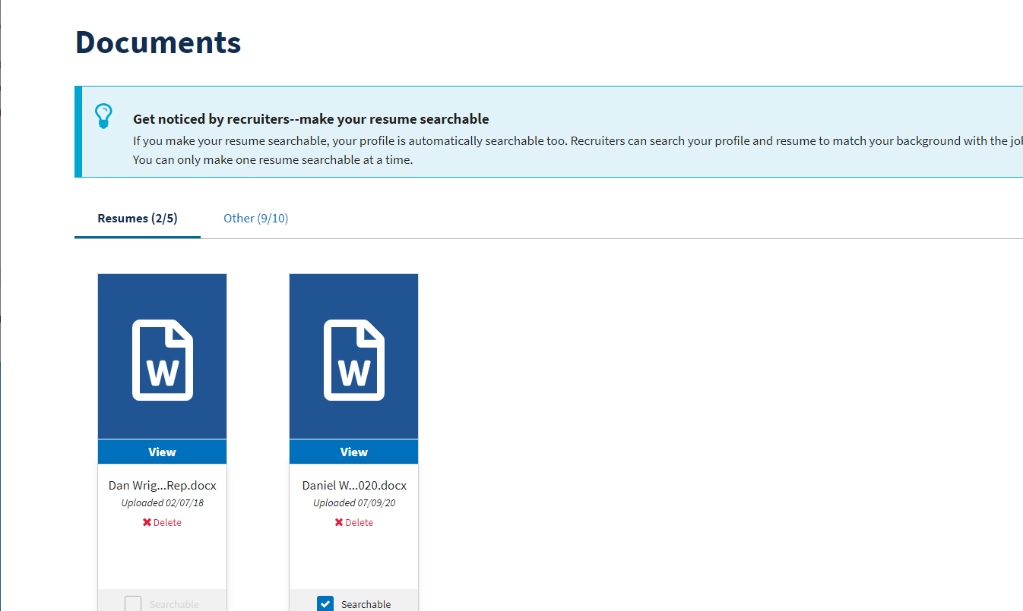
3. Uploading Required Documents
2 sub menus are now visible. Resumes and Other.
Resumes you can post up to 5 different resumes.
Other Documents you can post up to 10 different documents.

Slide 11
3. Uploading Required Documents
Here is a list of documents commonly required:
DD214 – Record of military service (member copy 2 or 4 required)
SF15 – Veteran Preference Form
SF50 – Personal Action Form for previous federal employees
VA Disability Letter – Percentage of disability on VA Letter Head
Schedule “A” Letter – Letter from Doctor or Counselor stating health or mental health issues(does not disclose).
Social Security Card
Cover Letter

Slide 12
3. Uploading Required Documents
Collect required forms.
Scan them and upload them to your USAJOBS.gov account.
Once uploaded they remain uploaded and can be used for any federal job that you apply to.

Slide 13
4. Creating a Federal Resume Using
the Resume Builder
Select “Documents” from the Home Page Menu.
Scroll down select the Upload or build resume icon.

Slide 14
4. Creating a Federal Resume Using
the Resume Builder
Select “Build Resume”
from the Add New Resume Menu.

Slide 15
4. Creating a Federal Resume Using
the Resume Builder
The Resume Builder will prompt.
Follow the on-screen instructions, enter information and hit next on each screen.
This will build your resume in the federal format.

Slide 16
5. Job searching / job searching tips
1. At the top of the home screen select “Search”
1.
2.
3.
2. Then Select a Location.
Most Likely Bay Pines, Florida
3. Hit this search button.

Slide 17
5. Job searching / job searching tips
A job list will present, and you can preview and apply to positions from this page.

Slide 18
5. Job searching / job searching tips
On the right-hand side of the screen, you can select some criteria that will refine your search.
You can select by Department or Agency.
Or by Job Series Number

Slide 19
5. Job searching / job searching tips
I selected Department of Veterans Affairs and went from 53 jobs down to 5 jobs, so this refined my job search.

Slide 20
6. Saving job postings
When searching for jobs we can save jobs to our account so that we don’t have to search for them again.
When you find a posting, you would like to save for later review, “Select Save Job”

Slide 21
6. Saving job postings
Click back on your name at the top of the screen.
This screen will prompt, showing you have a saved job.

Slide 22
7. Applying to Jobs
Select the title of the job to see the job description and application method

Slide 23
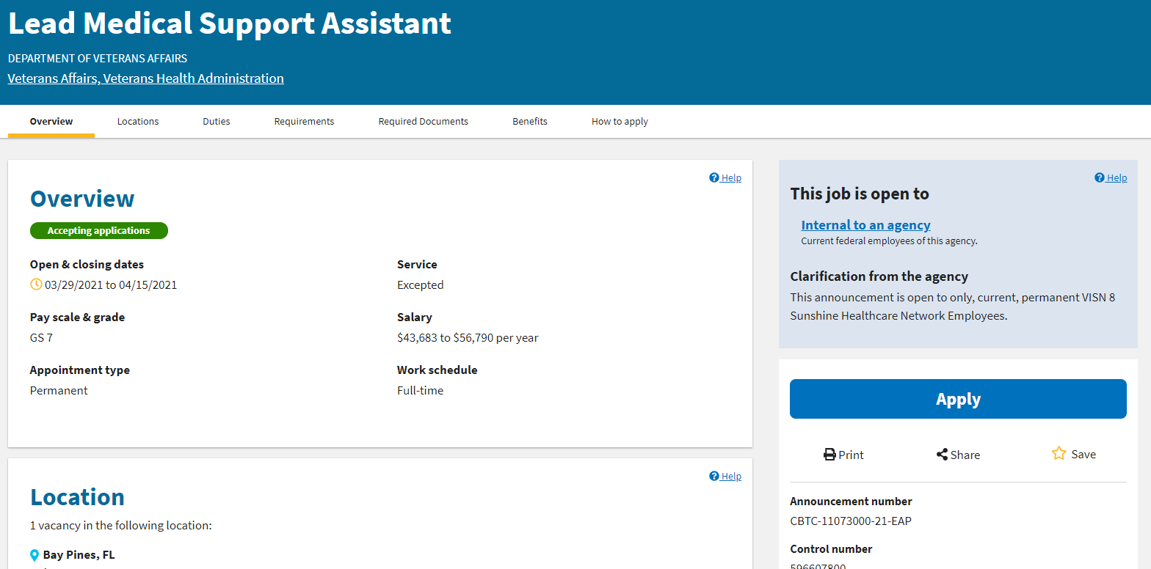
7. Applying to Jobs
Click Here to Apply
Notice closing dates, salary, GS Level and the Announcement Number can all be found on this page

Slide 24
7. Applying to Jobs
After selecting the apply button you will be guided through the application process, follow the instructions until you get to the submit page, once satisfied with the application select submit.
You must be logged in to your account and have a profile in order to apply to jobs on USAJOBS.gov

Slide 25
8. Checking the status of a job
From that same menu, select “Applications”.

Slide 26
8. Checking the status of a job
We can see from these 2 applications that the status is closed, the Hiring is Complete

Slide 27
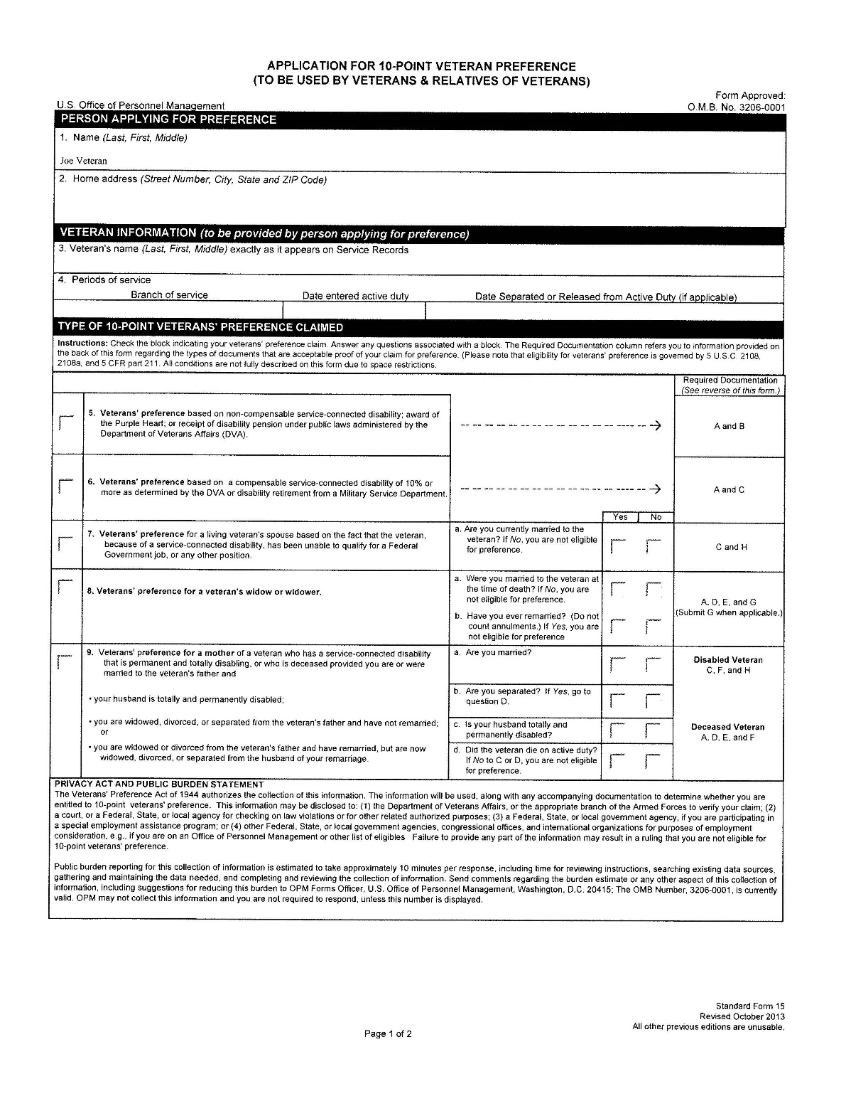
9. Veteran’s Preference Form SF15
The SF-15 form shows your level of veteran’s preference it takes about 5 minutes to fill out and can be downloaded from the internet after google searching for it. Choose the form filling PDF version.

Slide 28
QUESTIONS?
This has been a quick overview of some features on USAJOBS.gov.
I encourage you to explore additional features and tools this site has to offer.

Slide 29
CareerSource Pinellas Veteran Services Contact:
Natalia Dolsak, FCWP
DEO Veterans' Program Manager/Supervisor
Veterans at Work SHRM Certified
ndolsak@careersourcepinellas.com
Tel: 727-608-2486

